Slide 1
UiPath Platform Live Demo

Slide 2
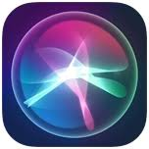

Live Scenario – Starting PowerPoint
Think Automation First
1
Starting roboter from Siri/Alexa or robot tray
2
Opening MS PowerPoint in presenter view

Slide 3
Live Scenario – Starting PowerPoint
Think Automation First
1
Starting roboter from Siri/Alexa or robot tray
2
Opening MS PowerPoint in presenter view

Slide 4
Live Scenario – Starting PowerPoint
Think Automation First
1
Starting roboter from Siri/Alexa or robot tray
2
Opening MS PowerPoint in presenter view

